Slide 1
DIVVY BIKES
CASE STUDY ON
BIKE SHARED OFFERING COMPANY IN CHICAGO
BY- SATYENDRA SINGH

Slide 2
SCENARIO:
Divvy bikes is a bike service provider which provides bikes for ride and has a two types of membership “casual” or “Member”.
It has three types of bikes
Classic bikes
Docked bikes
Electric bikes
The director of company wants a analysis on its members behaviour to understand the future aspects , related to which membership will bring the most benefit

Slide 3
Objective:-
Understand how casual riders(customers) and annual members(subscribers) of Cyclitic - Bike Share use Cyclitic bikes differently and come up with efficient recommendations to convert casual riders into annual members.
STAKEHOLDERS’S-
1-Lily Moreno - Director of Marketing
2-Cyclistic marketing analytics team
3-Cyclistic executive team

Slide 4
Findings:
member casual (subscription type) No out of the total
Customer 2529005
Subscriber 3066058

Slide 5
Ride length is the time between start point and end point
member_casual(Subscription type) ride_length (mean)
Customer 1920.1327
Subscriber 818.0129

Slide 6
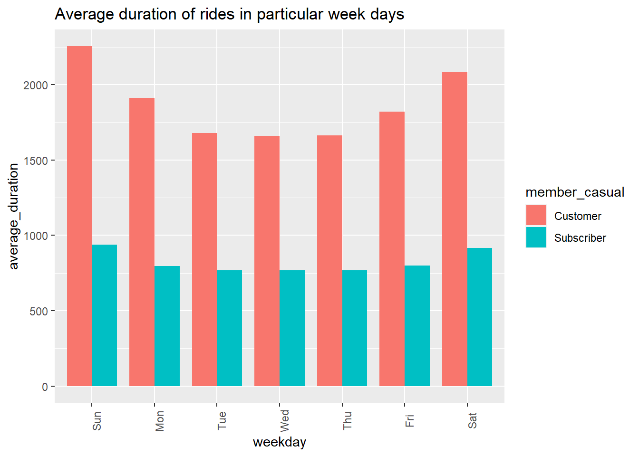

Slide 7
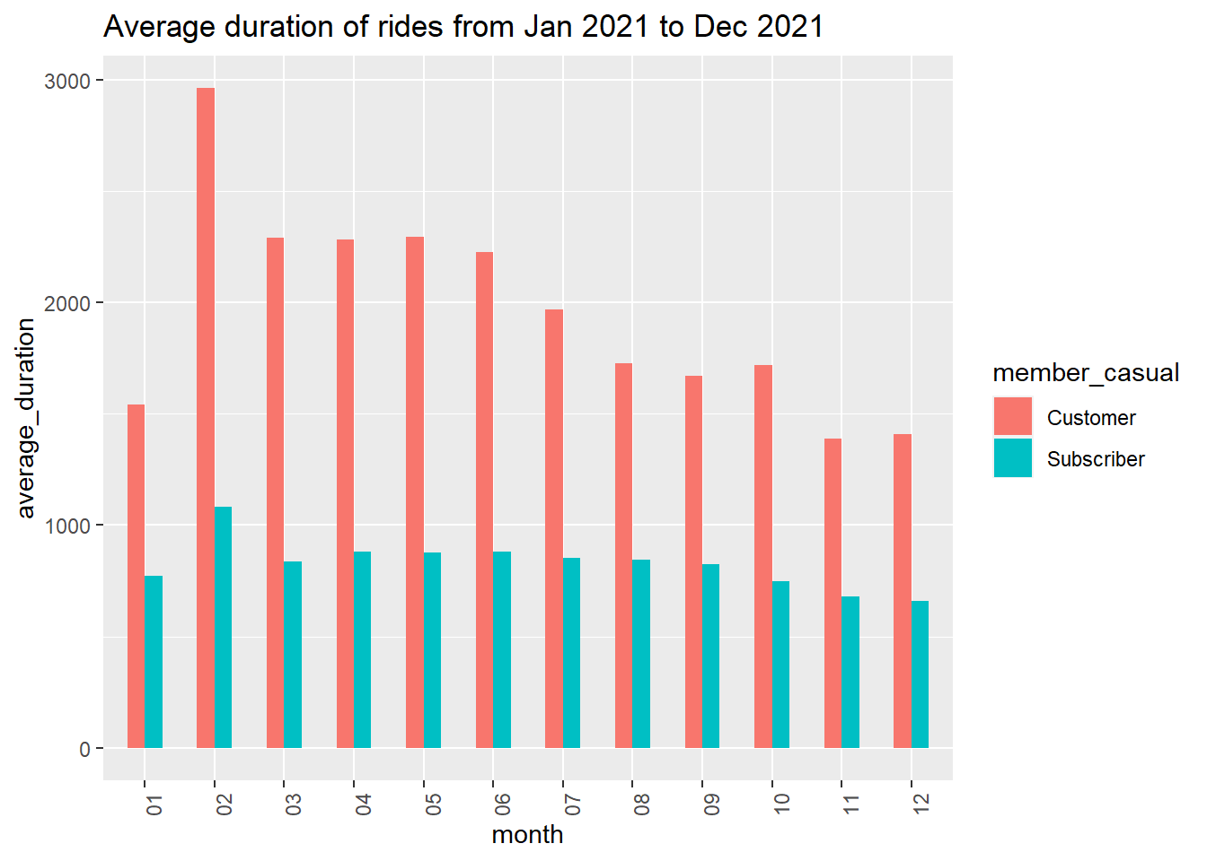

Slide 8
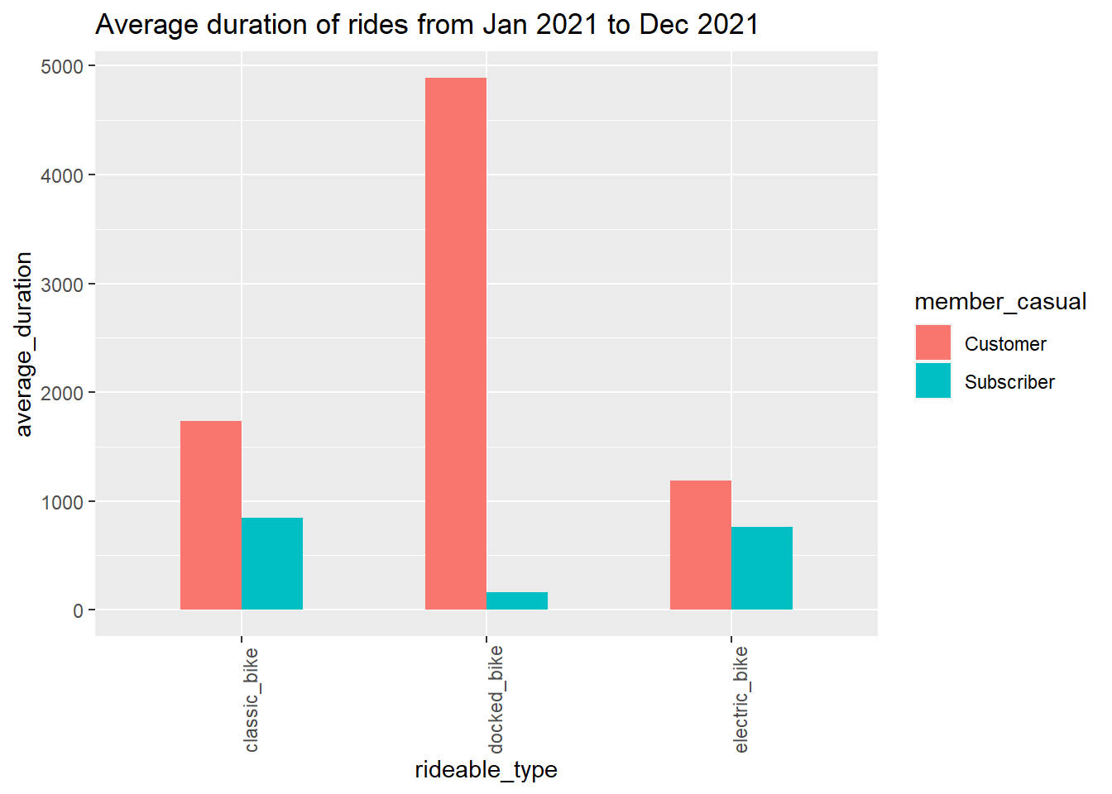

Slide 9
Outcomes:
Subscribers are more in the company as compare to customers (almost 10% difference)
Customers are doing the more ride then the subscribers
“Docked bike” is more famous among the customer and “classic bike “amongst the subscribers

Slide 10
Recommendations:-
A suitable offer for customer (casual riders) that will attract them to take annual membership i.e.
annual membership cost < daily membership/monthly membership cost
Company can introduce more docked bikes as it is famous amongst the riders
docked bikes > classic bikes > Electric bikes
Attractive Offers in weekdays

